Slide 1
Unit 6

Slide 2
Z buffer ALGM and Painters algm

Slide 3
Z-Buffer or Depth Buffer Algm

Slide 4
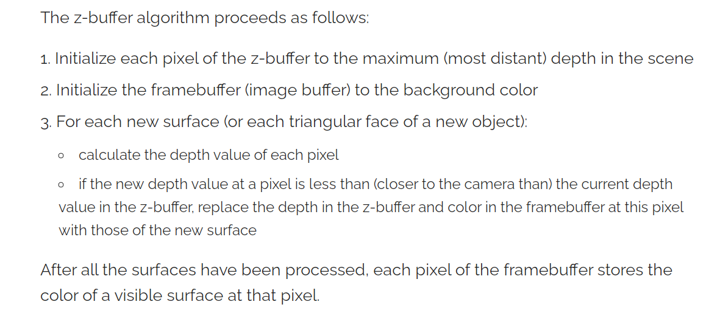

Slide 5
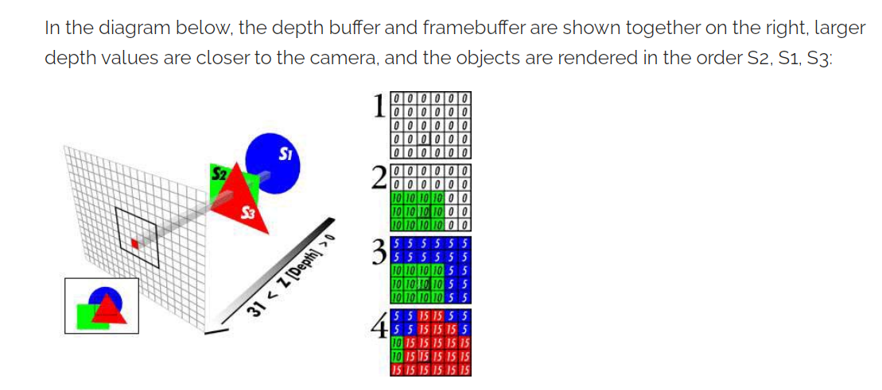

Slide 6
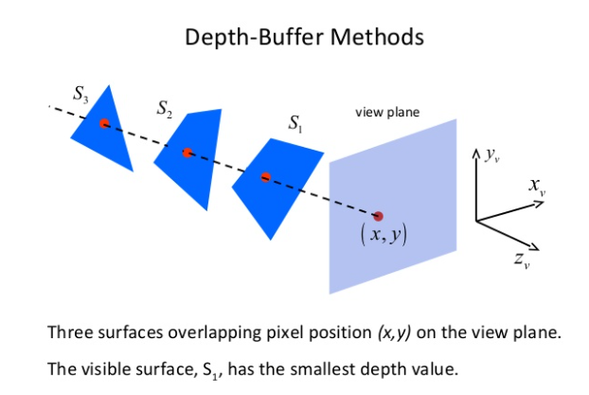

Slide 7
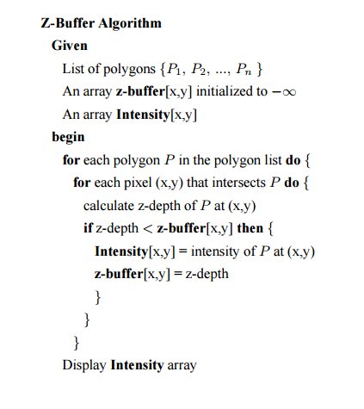

Slide 8
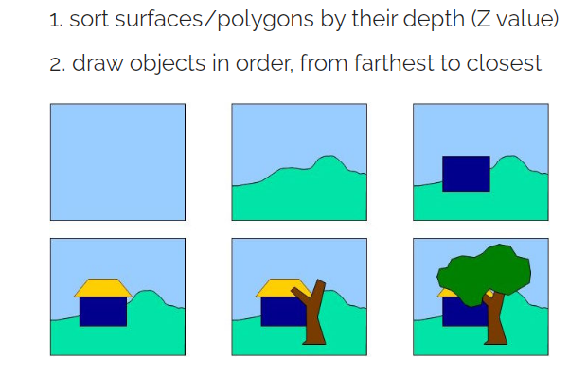
painter's algorithm (depth sort algorithm)
The painter's algorithm proceeds as follows:

Slide 9

Scenarios such as the following pose a challenge for the painter's algorithm

Slide 10
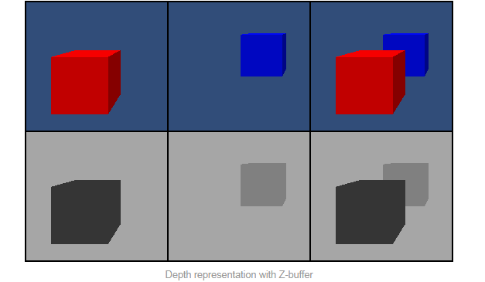

Slide 11
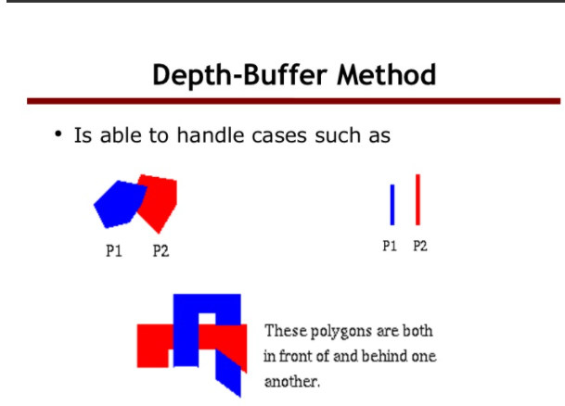

Slide 12
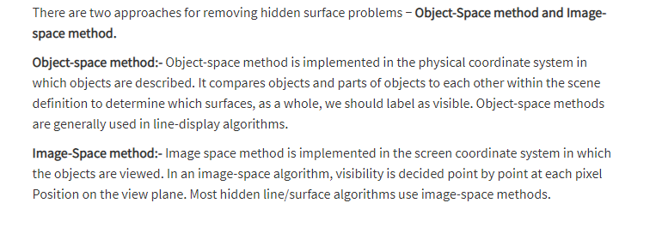

Slide 13
What is image space and object space?
Object space is the 3 dimensional space in which a graphic object is defined.
Image space is the projection of the object defined in 3D to two dimensional screen space.

Slide 14
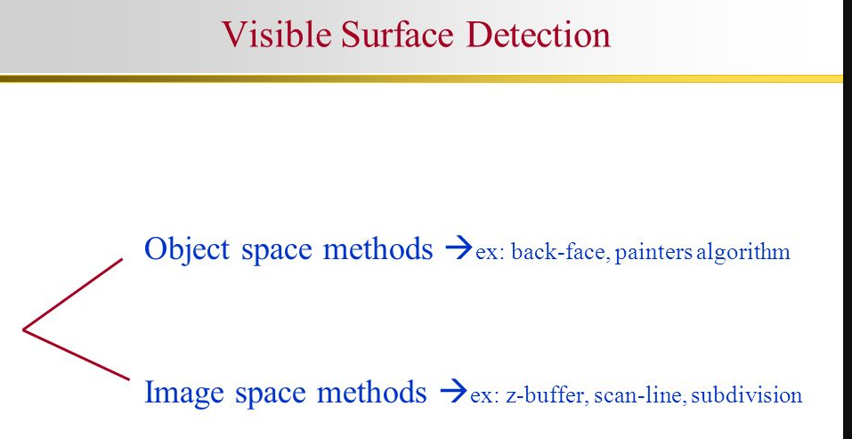

Slide 15
Visible surface detection link
https://youtu.be/j7zASv6vUKk

Slide 16
Video ref link
https://youtu.be/TsjYPu7piY0
https://youtu.be/GiEMoaaiesY
https://youtu.be/yhwg_O5HBwQ

